Slide 1

Shikha Singh
💼 Professional Experience (6+ Years)
🏢 Autodesk - Software Engineer (Feb 2023 - Feb 2025)
🏢 Autodesk - Software Engineer Intern (May 2022 - Aug 2022)
🏢 Accenture -Senior Software Engineer (Dec 2016 -Aug 2021)
🎓 Education
🏫 California State University, Long Beach MS in Computer Science (Aug 2021 – Dec 2022)
📧 singh.shikhasingh09@gmail.com | 📞 562-527-5295
🔗 linkedin.com/in/shikha-singh-434481102
Notes:
Hello and welcome everyone I am Shikha Singh.
I am an ex-Autodesk Software Engineer and I have 6+ years of software development experience.
I did my masters in computer science from California State University long Beach

Slide 2

Autodesk Ticketing System: Full Stack
A Scalable, Secure, and Slack-Integrated Ticketing Platform
Notes:
Today I’m excited to walk you through the Autodesk Ticketing System, a full-stack solution I built to streamline internal support with secure workflows and real-time Slack integration."

Slide 3
Agenda
Problem Statement
Scalability, Performance, Optimization
Proposed Solution and Overview
Slack Notification
Core Functionality
Live Demo
Architecture Diagram
Technology Stack
Security Highlights
Future Enhancements and Q&A
Notes:
Here’s a quick look at what we’ll be covering today. We’ll start by discussing the initial problem statement that led to the creation of the Autodesk Ticketing System."
"Next, I'll present the proposed solution and give you a general overview of the platform. We’ll then go into the core functionalities, explaining how the system operates."
then the architecture diagram, providing insight into the technical design. We will also review the security highlights, scalability, performance optimizations, and Slack integrations."
Finally we’ll move into the Live Demo and later discuss the technology stack used. We'll then touch future enhancements planned for the system and conclude with a Q&A session.".

Slide 4
Problem Statement -
A Hypothetical Situation
🧩 Lack of Unified Platform
🤷 Lack of Accountability
⏱️ Missing SLAs
📉 Poor Visibility for Stakeholders
Notes:
This is a hypothetical situation reflecting the challenges being faced in an organisation
I encountered -
🧩 Lack of a Unified Platform – Tickets were scattered across emails, chats, and spreadsheets, making it hard to track ownership and status.
🤷 Significant Lack of Accountability – Without clear assignees or update history, tickets often went unacknowledged or unresolved.
⏱️ We Struggled with Missing SLAs – due to inability to define, enforce, or monitor ticket response and resolution timelines.
📉 Stakeholders had poor visibility – into open issues and priorities, impacting overall support efficiency

Slide 5
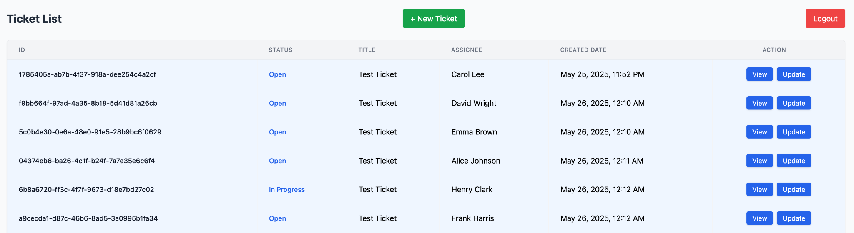
Proposed Solution & Overview
Built Autodesk Ticketing Platform
Notes:
"I built the Autodesk Ticketing Platform to directly address the issues we just discussed."
"This platform provides a unified space for ticket management and streamlines resolution for internal and external teams."
"Key features include a unified platform, clear accountability, defined SLAs, and improved visibility for stakeholders."
"I have implemented a centralized system for ticket creation, updation, and tracking for all users."
"I have also implemented ownership tracking and notifications to ensure timely responses and actions."
✅ Built Autodesk Ticketing Platform
Designed and deployed a secure, scalable ticketing platform that streamlined issue tracking and resolution for internal teams and external customers.
💡 Impact & Benefits
🧩 Unified Platform: Centralized all ticket creation, updates, and tracking in one system for engineers, support, and business stakeholders.
✅ Clear Accountability: Introduced ticket ownership, status auditing, and automated notifications to ensure timely responses.
⏱️ Defined SLAs: Enabled structured response/resolution times with status-based workflows and Slack alerts.
📊 Improved Visibility: Delivered real-time ticket dashboards and filters for priority, assignee, and status — enabling better decisions and escalations.

Slide 6

🛠️ Core Functionalities
✏️ CRUD Operations on Tickets
🔐 Secure User Creation & Login (JWT Auth)
Slack Integration
💻 Console Support for User Workflows
Notes:
🛠️ Core Functionality of the Autodesk Ticketing Platform
"Now, let's discuss the core functionalities of the Autodesk Ticketing Platform."
"The platform provides end-to-end support for the entire ticket lifecycle and secure user access, along with integrated team collaboration features."
"Key capabilities include:
✅ Key Capabilities
✏️ CRUD Operations on Tickets allowing users to Create, view, update, and delete tickets with support for various fields like status, description, assignee, and priority.
🔐 Secure User Creation & Login (JWT Auth) using Json web Token Authentication - ensuring only authorized users have access and can manage tickets.
🔔 Slack Integration providing Real-time Slack notifications on ticket creation and updates to keep teams aligned without needing to switch between platforms.
💻 Console Support for Admin Workflows a UI friendly interface for operational teams to manage user capabilities and perform all necessary operations

Slide 7
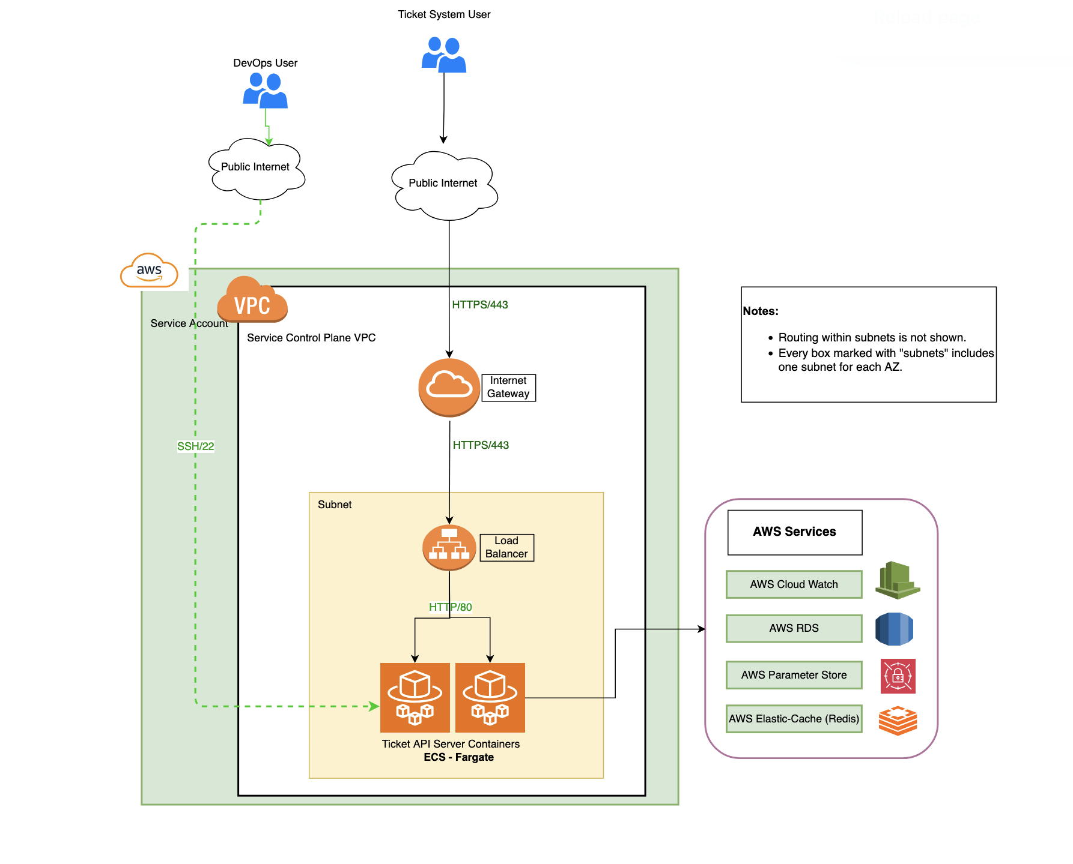
Architecture Diagram
Notes:
This architecture diagram here represents a cloud-native ticketing system deployed on AWS.
Ticket system users accessing the API over HTTPS via the internet Gateway and traffic is routed to a Load Balancer
Behind the load balancer, the actual API logic runs inside ECS Fargate containers.
"The containers interact with several AWS-managed services for observability and persistence:
AWS CloudWatch: for logging
AWS RDS: our relational database for ticket storage
AWS Parameter Store: securely stores config and secrets
AWS ElastiCache (Redis): for caching and improving response times"
DevOps engineers can connect via SSH (port 22) to the VPC using a service account. This is tightly controlled with IAM roles and security groups.

Slide 8
Security Highlights
🔐 JWT Authentication
🛡️ SQL Injection & XSS Prevention
🧊 Database Encryption at Rest
📏 Input Validation with Pydantic
✅ HTTPS Encryption at Transit
Notes:
Let’s talk about the security measures implemented in the Autodesk Ticketing System."
I have used JWT authentication for secure user login
To keep the system secure from SQL injection attacks, all database interactions use SQLAlchemy ORM with parameterized queries, preventing malicious code from being inserted into our database queries..
To protect against Cross-Site Scripting, or XSS, React automatically escapes all output, preventing potentially harmful scripts from running in the browser.
database encryption at rest is achieved using AWS RDS with KMS-backed keys to protect sensitive data."
Input validation with Pydantic ensures field-level constraints like length limits, regex validation, and whitespace stripping are enforced.
Finally! I've enforced HTTPS encryption using AWS ACM certificates and an Application Load Balancer for secure communication."
🔐 Security Highlights
✅ HTTPS Encryption Enforced secure communication using AWS ACM certificates and Application Load Balancer (ALB).
🔒 SQL Injection Prevention All database operations handled through SQLAlchemy ORM with parameterized queries.
🛡️ XSS Protection React escapes all output by default; optional use of DOMPurify for sanitizing rich HTML content.
📏 Input Validation with Pydantic Enforced field-level constraints including length limits, regex validation, and whitespace stripping.
🔐 JWT Authentication (Optional Role-Based Access) Secure user login with token-based authentication; supports future integration of user roles and permissions.
🧊 Database Encryption at Rest
PostgreSQL storage encrypted using AWS RDS with KMS-backed keys to protect sensitive data.

Slide 9
Scalability, Performance, Optimization
⚖️ Scalability via AWS ECS + Load Balancer
⚡ High Performance with AWS ElastiCache (Redis)
🧠 Optimized Querying via PostgreSQL Indexing
Notes:
Now, let’s dive into how I’ve ensured the Autodesk Ticketing System is scalable, performant, and optimized."
1 - The architecture is horizontally scalable, using ECS Fargate behind an Application Load Balancer. This allows for automatic traffic distribution and failover, ensuring the system can handle increased loads seamlessly."
2 - For High Performance, I’ve integrated AWS ElastiCache (Redis). This Redis caching layer reduces database load and significantly improves ticket read and query latency, resulting in faster response times."
3 - To optimize Querying, I’ve implemented PostgreSQL Indexing. Indexes have been added on frequently queried fields such as status, assignee, and created_at. This accelerates filtering and sorting, leading to much quicker data retrieval."
🚀 Scalability, Performance & Optimization
⚖️ Scalability via AWS ECS + Load Balancer Horizontally scalable architecture using ECS Fargate behind an ALB for automatic traffic distribution and failover.
⚡ High Performance with AWS ElastiCache (Redis) Integrated Redis caching layer to reduce database load and improve ticket read/query latency.
🧠 Optimized Querying via PostgreSQL Indexing Added indexes on frequently queried fields (status, assignee, created_at) to accelerate filtering, sorting, and pagination.

Slide 10
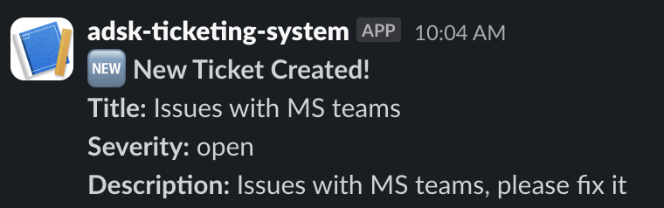
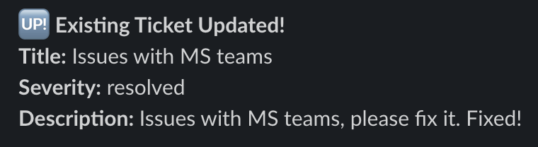
Slack Notification Integration
Auto-triggered on ticket creation or update
Notifies support/engineering teams in real time
Uses Slack Webhook API
Example:
Notes:
Let's discuss how I've integrated Slack into the Autodesk Ticketing System."
"Automated Slack messages are triggered whenever a ticket is created or updated."
"This keeps engineering and support teams instantly informed, without them having to leave their primary workspace."
"The Slack notification integration was implemented using the Slack Webhook API."
"Here are some examples of the types of notifications that are sent: 'New Ticket Created!' or 'Ticket Updated: Status Changed'."
Automated Slack messages are triggered whenever a ticket is created or updated
Keeps engineering and support teams instantly informed without leaving their workflow
Implemented using FastAPI background tasks and the Slack Webhook API
Example: 🆕 New ticket created:
✏️ Ticket updated: Status changed

Slide 11
Live Demo
Notes:
Now let me give a quick demo of the application to get the look and feel for the system and see all the core functionalities

Slide 12
Technology Stack
Programming Language: Python & TypeScript
Frameworks: FastAPI (Backend), React + TailwindCSS + Vite(Frontend)
Database: PostgreSQL
Cloud Services: AWS (ECS, ALB, RDS, CloudWatch, VPC and ..more )
Caching: AWS ElastiCache (Redis)
Integrations: Slack Webhook API for real-time notifications
Infrastructure as a code: Terraform
Notes:
"Let's delve into the technology stack behind the Autodesk Ticketing System."
"The primary programming languages used are Python for the backend and TypeScript for the frontend."
"For the backend, I utilized FastAPI, while the frontend is built with React, TailwindCSS, and Vite framework."
"The database is PostgreSQL."
"I used a range of AWS cloud services, including ECS Fargate, ALB, RDS, Route 53, ACM, CloudWatch, VPC, and Secrets Manager."
"For caching, I have used AWS ElastiCache."
"Real-time notifications are powered by integrations with the Slack Webhook API."
"Infrastructure as code is managed using Terraform for efficient deployment and management."

Slide 13
Future Enhancements
Role-Based Access Control for admins, agents, and viewers
Email Notifications for ticket updates and SLA reminders
Analytics Dashboard for ticket trends, SLA breaches, and team performance
Integration with CI/CD or JIRA for developer handoffs
Full-Text Search and advanced filtering for large-scale ticket sets
Audit Logs to track user actions and system events
Notes:
""Now, let’s look ahead at some of the future enhancements I have planned for the Autodesk Ticketing System."
"First, I plan to implement Role-Based Access Control. This will allow us to have different access levels for admins, agents, and viewers, providing more granular control over our system permissions."
"We'll also introduce Email Notifications for ticket updates and SLA reminders. This will provide another channel for users to stay informed, in addition to Slack notifications."
"An Analytics Dashboard is also on the roadmap. This dashboard will help us track ticket trends, identify SLA breaches, and monitor team performance, allowing for data-driven improvements."
"I am also considering Integration with CI/CD or JIRA. This would facilitate seamless handoffs for developers and streamline workflows."
"To better manage large-scale ticket sets, I can add Full-Text Search and advanced filtering capabilities. This will make it much easier to find specific tickets and information."
"Lastly, I plan to add Audit Logs. This feature will track user actions and system events, providing a comprehensive record for security and compliance purposes."
"These enhancements will continue to improve the functionality and efficiency of the Autodesk Ticketing System, making it even more valuable for our teams."

Slide 14
Thank you!
Q&A
Notes:
Thank you for your time and attention. Any questions?

